Slide 1
Running WRF with ndown
Charles Philip Johnson

Slide 2
The Process
Real
WRF for 1st Domain
ndown
WRF for 2nd Domain
ndown
WRF for 3rd Domain
These steps are also available on page 5-17 (page ~124) of the wrf4.2 guide
This guide is recommended even if you use an earlier version of wrf because it includes steps for 3 domains instead of just two.

Slide 3
Real
Assuming you’ve done WPS for a 3-domain simulation as normal
Run real.exe with max_dom set for all 3 domains.
Should produce a wrfbdy_d01 and multiple wrfinput_d0 files.
If you’re running with wrflowinp_d0 files those will be produced as well.
In a sub-directory, make a copy of your namelist.input and the wrf input files generated via real.

Slide 4
WRF for 1st Domain
Within the namelist.input set “max_dom” from 3 to 1
Makes WRF only run for the 1st domain
Run ./wrf.exe for the first domain

Slide 5
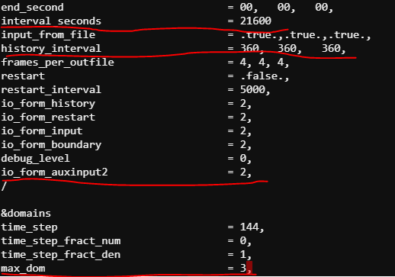
Ndown to the 2nd domain
After successfully running WRF for the 1st domain
Open namelist.input
In the “&time_control” section, add the following line
io_form_auxinput2=2,
Set “interval_seconds” to equate the “history_interval” of the 1st domain run
One is in seconds the other is in minutes so be wary
Found it easiest if all 3 domains have the same history_inverval and interval_seconds
Change “max_dom” from 1 back to 3
Close and save

Slide 6

Ndown to the 2nd domain
Rename wrfinput_d02 to wrfndi_d02
Don’t touch the wrflowinp_d0 files if using them, they’re not necessary for ndown
Run ndown
./ndown.exe or submit a .pbs job for a lengthier simulation
ndown relies on the wrfout files so leave them in the run directory when you execute the ./ndown.exe command

Slide 7
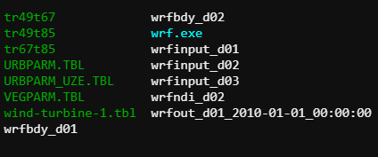
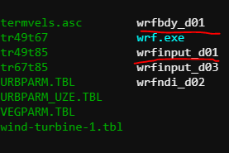
Ndown to the 2nd domain
Check the rsl files for a success message
ndown produces a wrfinput_d02 and wrfbdy_d02 file
Rename wrfinput_d02 to wrfinput_d01
Rename wrfbdy_d02 to wrfbdy_d01
Rename wrflowinp_d02 to wrflowinp_d01
Move the wrfout files from the 1st domain to another directory
Running wrf with ndown means that every domain you run will be called d01 and thus the 2nd domain output files would overwrite the 1st domain outputs

Slide 8
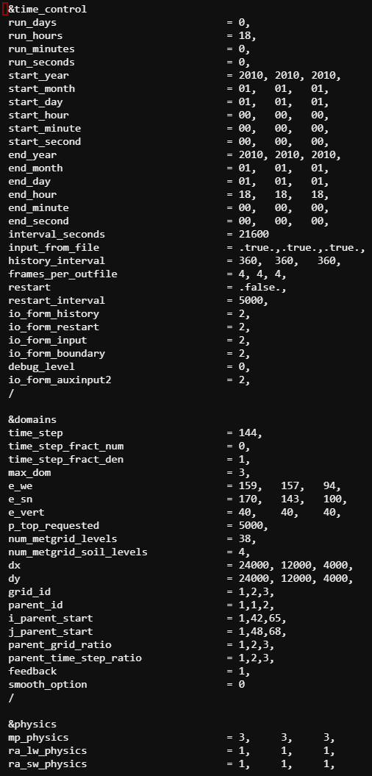
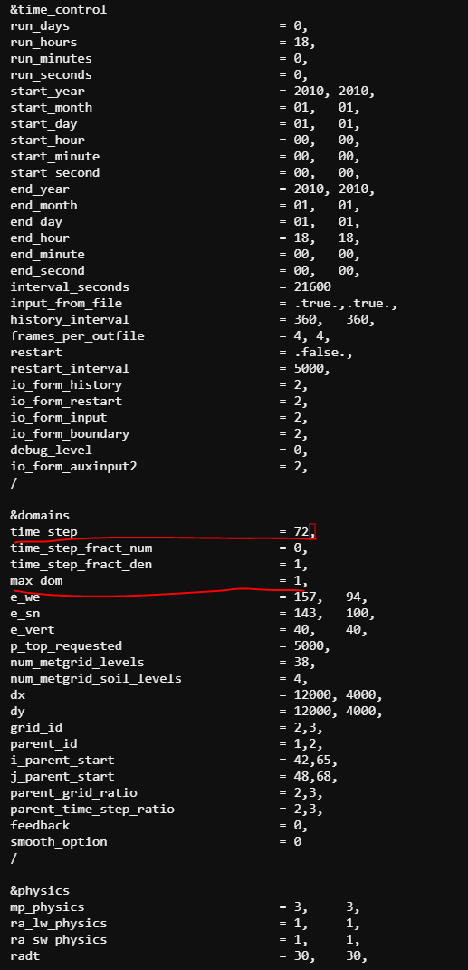
WRF for 2nd Domain
Save a copy of your original namelist.input as namelist.input.d01
Open your namelist.input
Move the data from the 2nd column to the 1st so that this run is for the 2nd domain
Set “time_step” to be 6*(your 2nd domain dx value)
Set “max_dom= 1,”
Leave “specified = .true.,”
Leave “nested = .false.,”

Slide 9
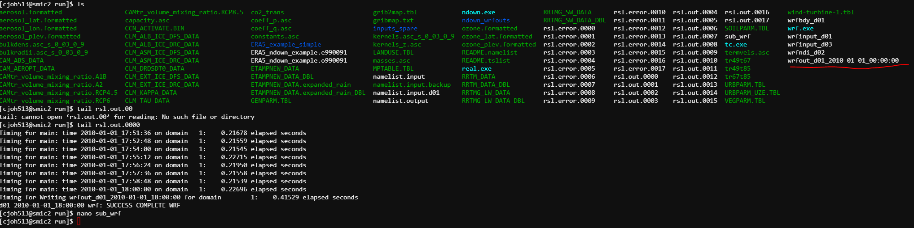
WRF for 2nd Domain
Close and save your namelist.input
Save a copy as namelist.input.d02
Run wrf.exe for the 2nd domain
Check for a success message and that another set of wrfout files are created

Slide 10
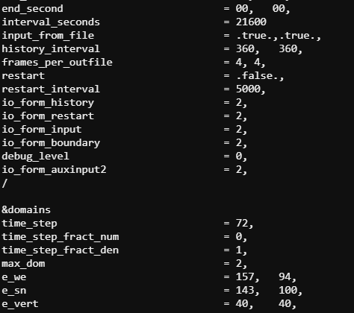
Ndown to the 3rd domain
Rename “wrfinput_d03” to “wrfndi_d02”
Open namelist.input
Set “max_dom” from 1 to 2
Make sure “io_form_auxinput2=2,” is present
Make sure “inverval_seconds” equates the “history_interval” from the 2nd domain’s output
Run ndown
./ndown.exe

Slide 11
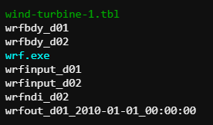

Ndown to the 3rd domain
Check for a successful ndown message
Ndown will produce a “wrfinput_d02” and “wrfbdy_d02”
Change wrfinput_d02 to wrfinput_d01
Change wrfbdy_d02 to wrfbdy_d01
Change wrflowinp_d03 to wrflowinp_d01
Move your wrfout files to a separate directory where you know they actually correspond to the 2nd domain

Slide 12
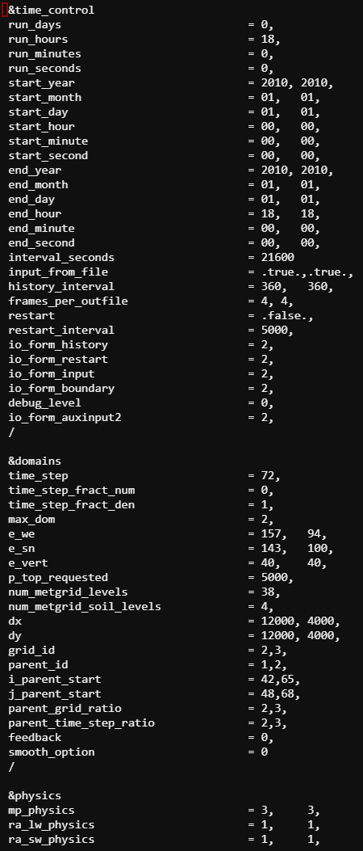
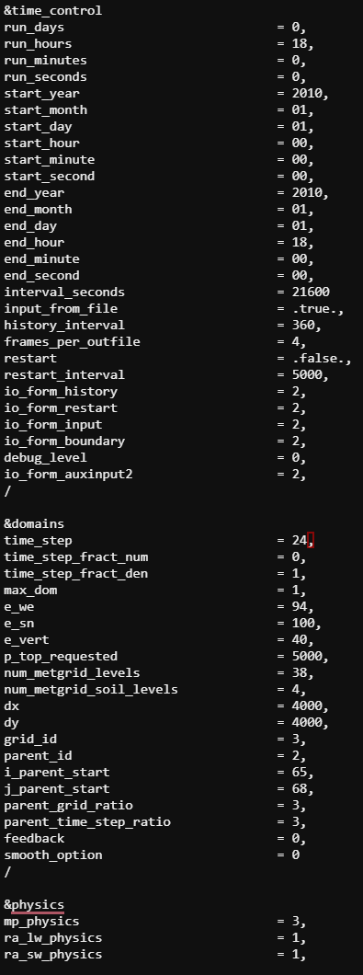
WRF for 3rd Domain
Save a copy of the namelist.input you used for the 2nd domain as namelist.input.d02
Open your namelist.input
Move the data from the 2nd column to the 1st so that this run is for the 2nd domain
Set “time_step” to be 6*(your 2nd domain dx value)
Set “max_dom= 1,”
Leave “specified = .true.,”
Leave “nested = .false.,”
Save and close
Run WRF

